Slide 1
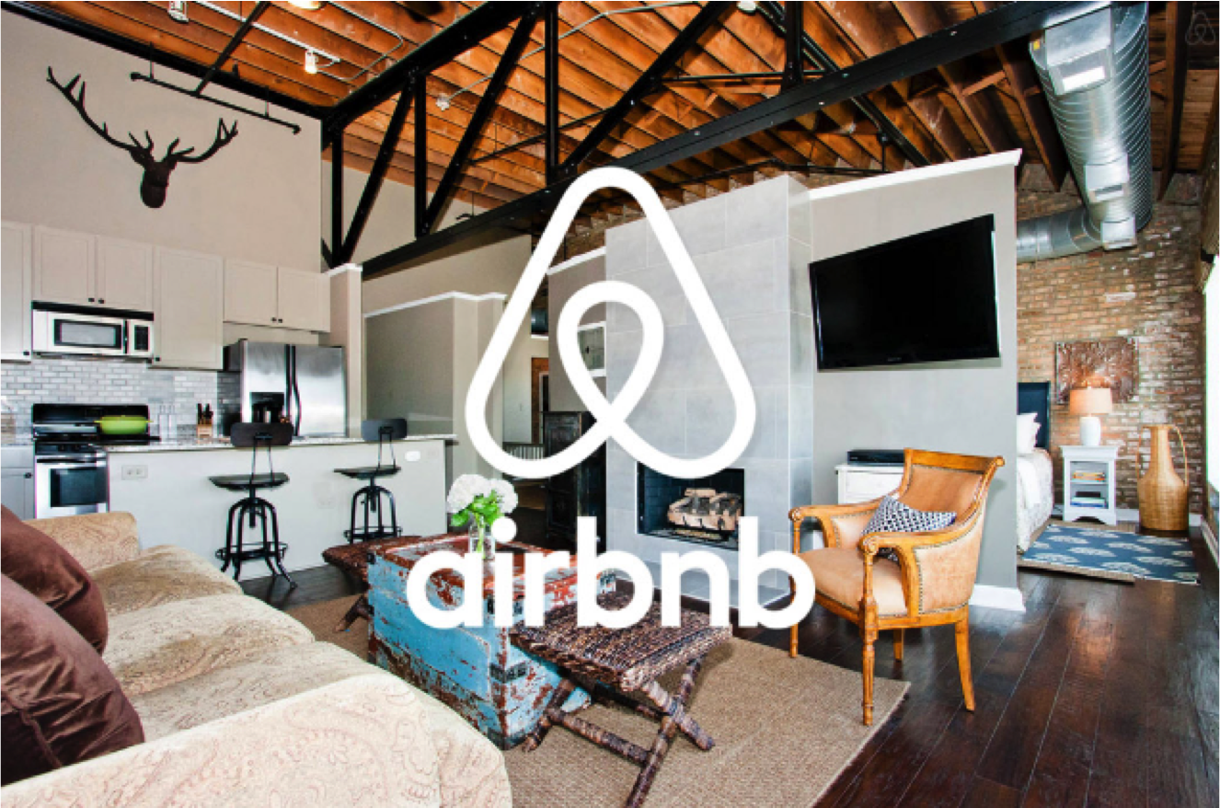
T
Notes:
Image source :
Google Airbnb Images

Slide 2
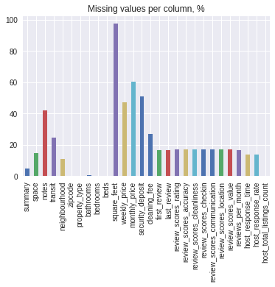
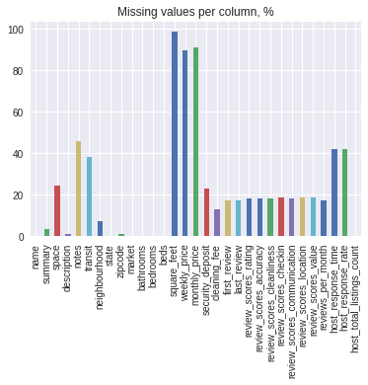
Missing value in Seattle and Sandiego Datasets
Seattle Sandiego
Notes:
We are trying to compare our methodologies with different other cities.So in that we have chosen san diego to be compared with seattle data.
In this missing values ,the highest percent for both is square feet and monthly price .

Slide 3
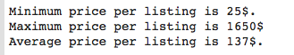
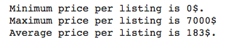
Average Price per listing
Seattle Sandiego
Notes:
Average price varies from min 25 to 0
max is 1650 and 7000
Average 137 & 183

Slide 4
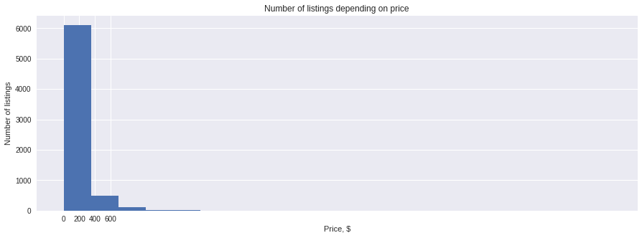
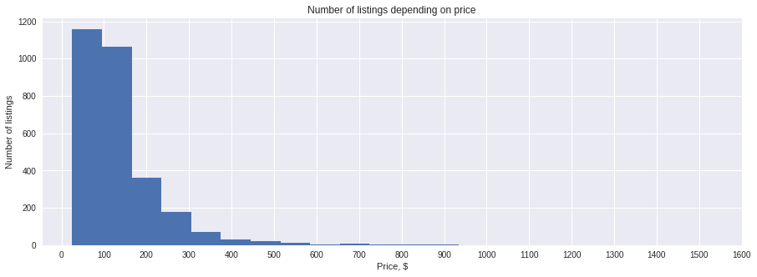
Listings and Price Plot
Seattle Sandiego

Slide 5
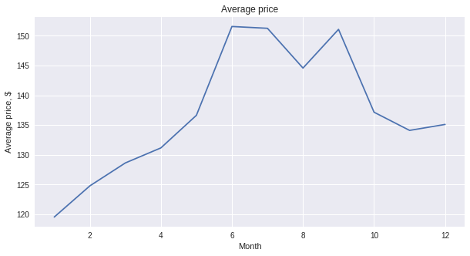
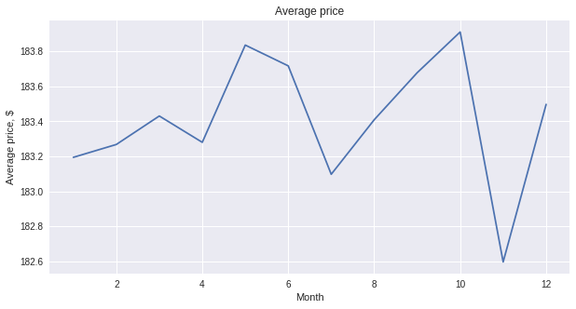
Average price per month
Seattle Sandiego
Notes:
For Seattle price are super high in the July month
For Sandiego price are high in November

Slide 6
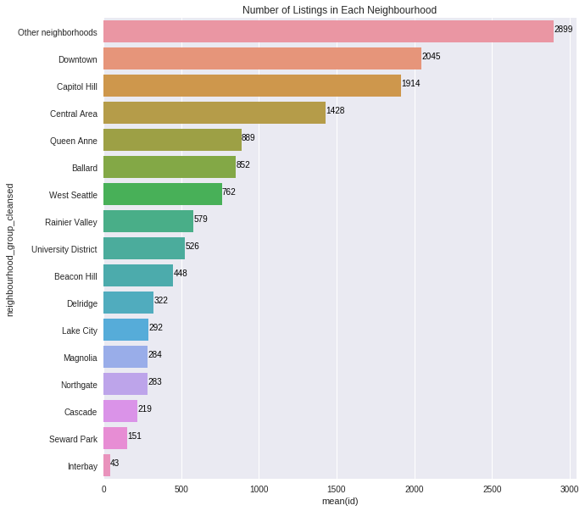
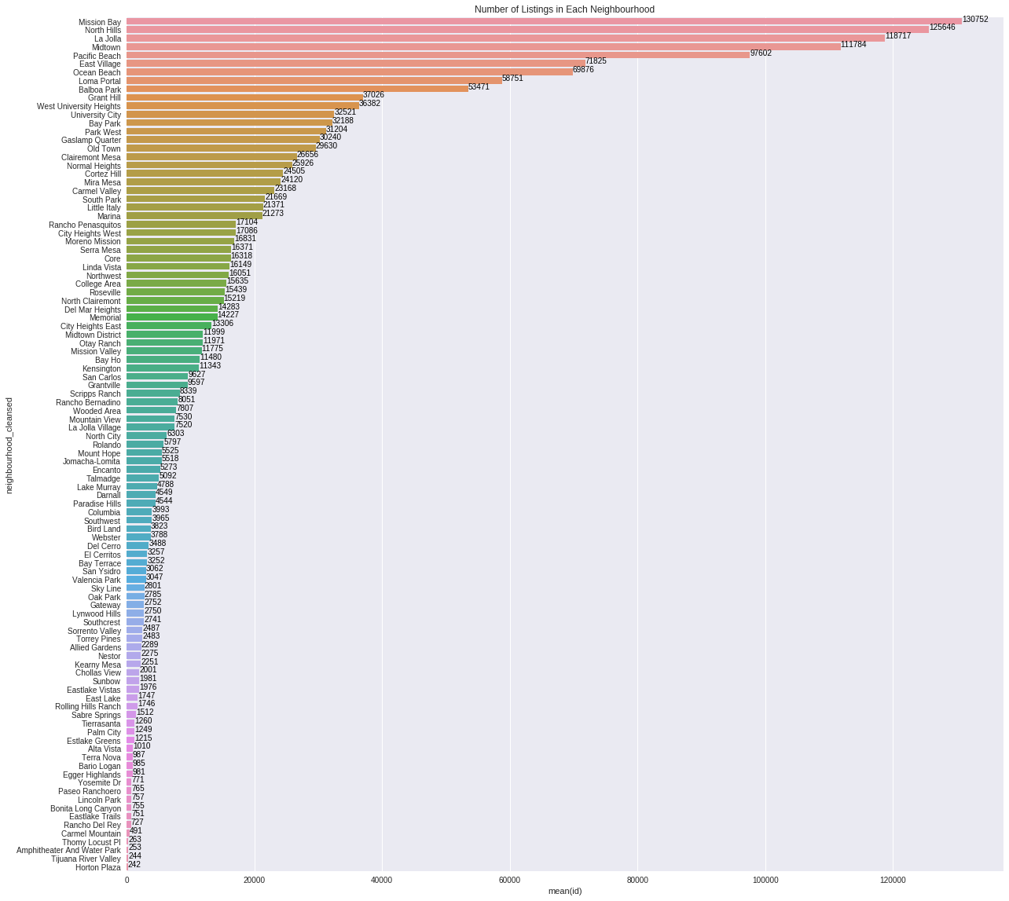
Listings per neighbourhood
Seattle Sandiego
Notes:
Highest neighbourhood percentage in Seattle Downtown,other neighbourhoods,Capitol Hill,Central Area
for Sandiiego: Mission bay,North hills,La jolla ,Midtown

Slide 7
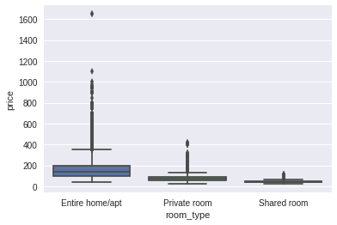
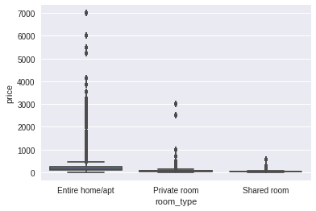
Room Type BoxPlot
Seattle Sandiego
Notes:
For the each room type and difference in price

Slide 8
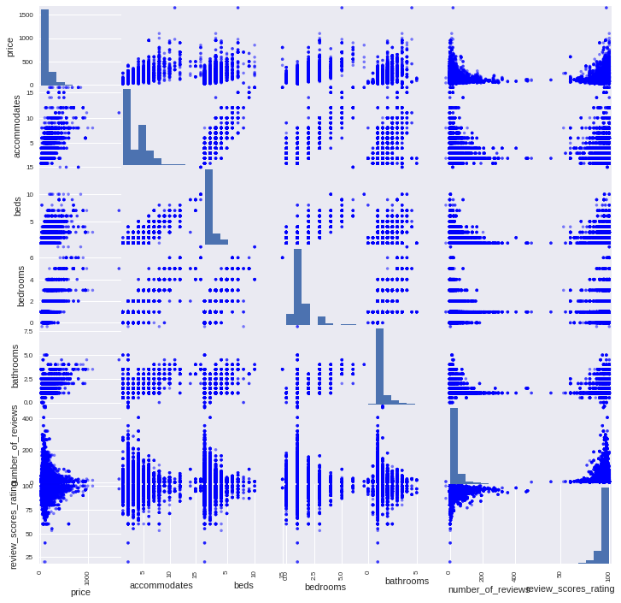
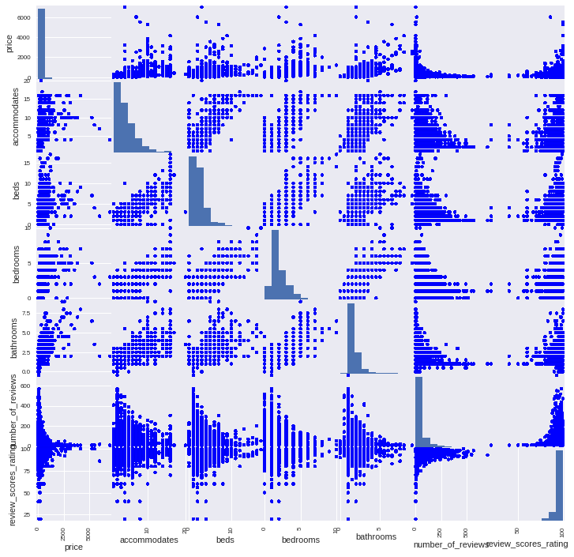
Scatter Plot
Seattle Sandiego
Notes:
these are scatter plot for the important features like price,accommodates,beds,bedrooms,bathrooms number of reviews & review score rating

Slide 9
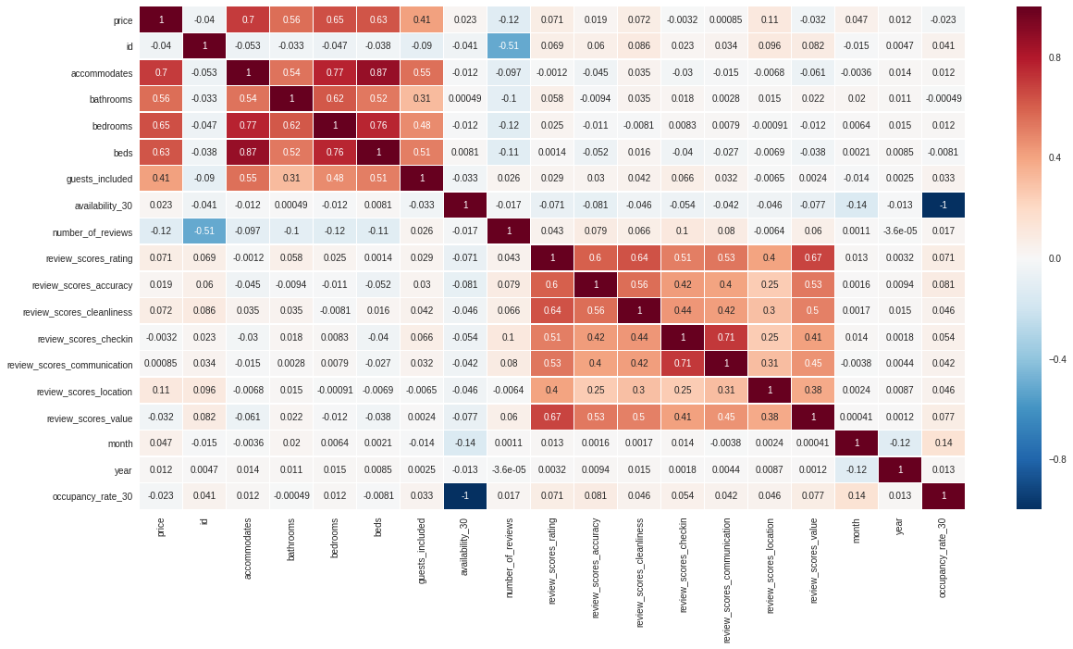
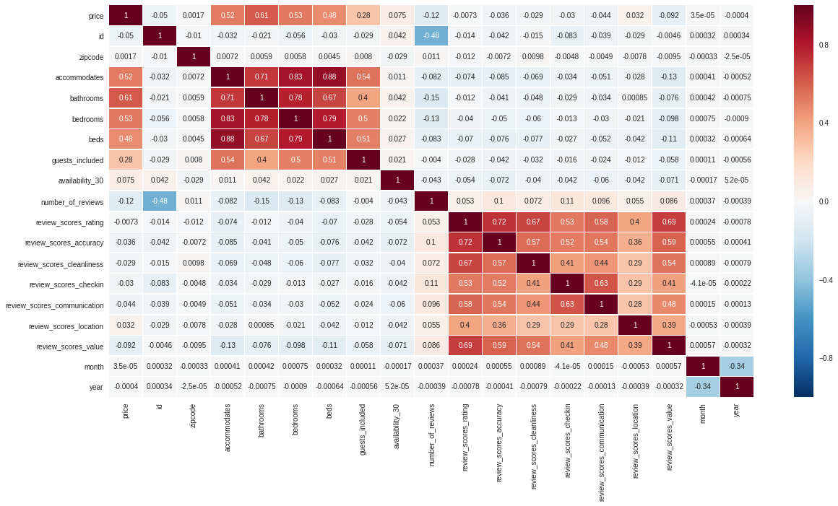
Heat Map
Seattle Sandiego
Notes:
Seattle Price: Accommodates,Bedrooms,Beds,bathrooms correlates good
Sandiego Price : Bedrooms,Bathrooms,Accommodates

Slide 10
Clustering(Kmeans,GMM)
Notes:
We have done clustering in order to group similar data points.

Slide 11
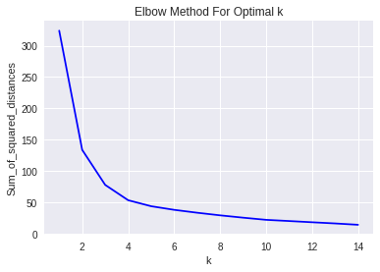
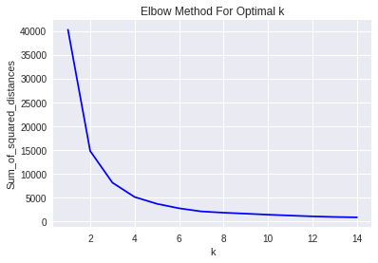
Elbow Method
Price and Accommodates
Seattle Sandiego
Notes:
from the elbow method we understood that Cluster Number is same 5 for both

Slide 12
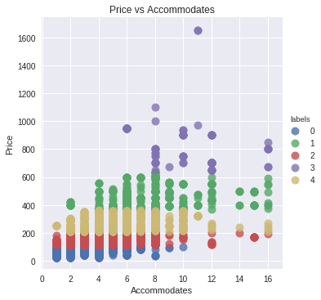
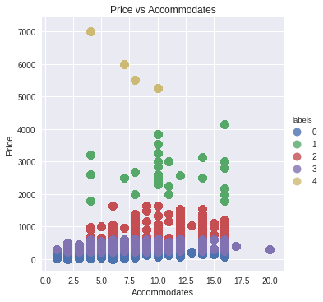
Kmeans
Price and Accommodates
Seattle Sandiego
Notes:
Outlier for Seatlle : Accommodates 10 price is 1700
Outlier for Sandiego : Accommodates 4 price is 6500
Prices positively correlated with the accommodates

Slide 13
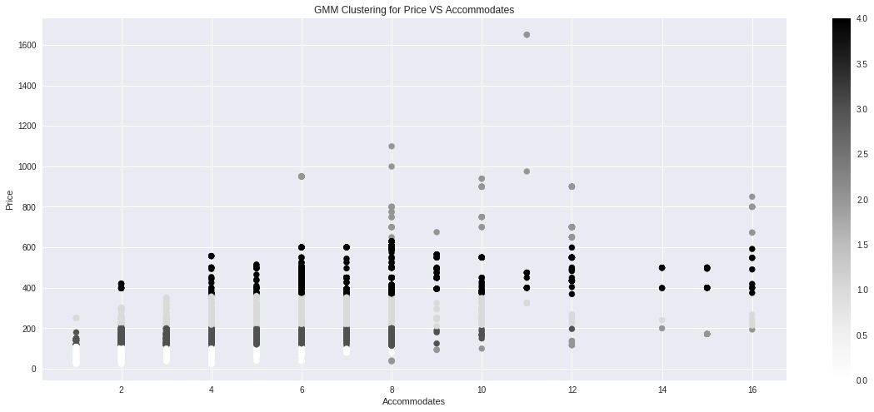
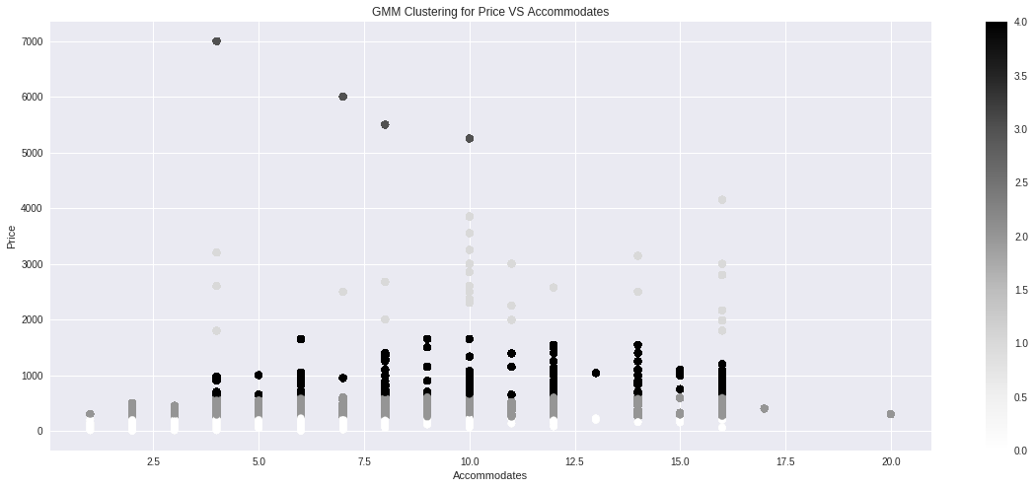
GMM
Seattle Sandiego

Slide 14
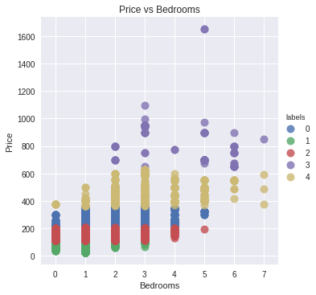
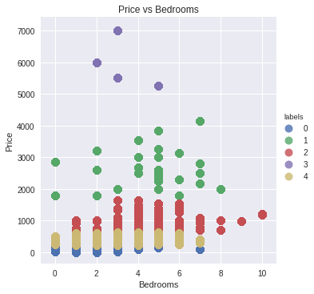
Kmeans
Price and Bedrooms
Seattle Sandiego
Notes:
Outliers:
Seattle -Bedrooms 5 price is 1600
Sandiego - Bedrooms 4 price is 7000

Slide 15
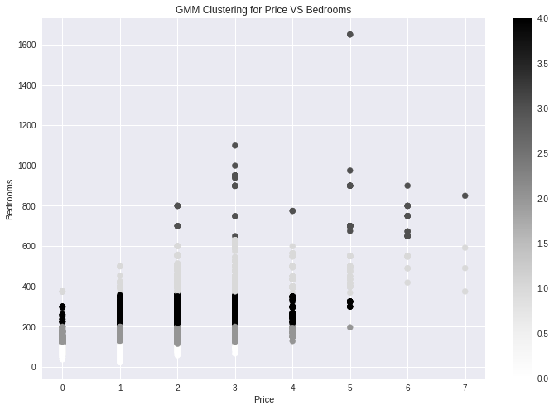
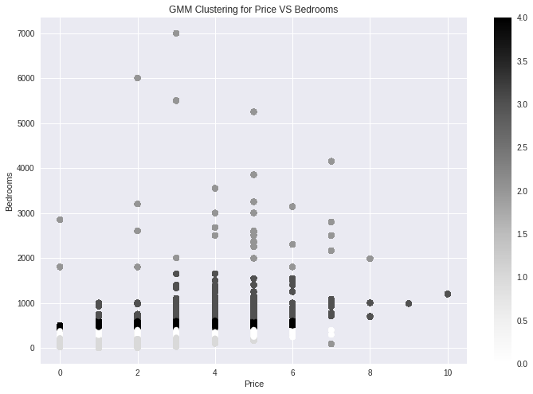
GMM
Seattle Sandiego
Notes:
Outlier for Seatlle : Accommodates 5 price is 1700
Outlier for Sandiego : Accommodates 3 price is 6500

Slide 16
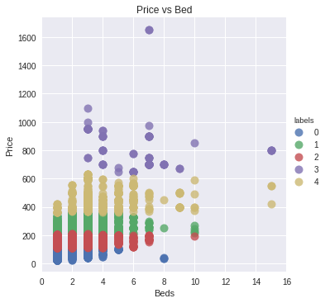
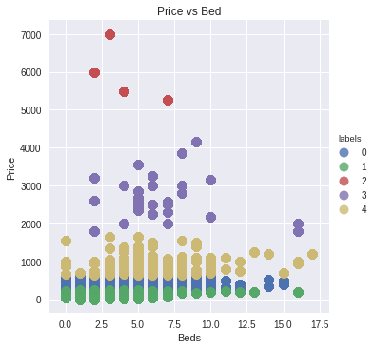
Kmeans
Price and Beds
Seattle Sandiego
Notes:
Outlier
Seattle 8 Beds Price is 1700
Sandiego 5 Beds price is 7000

Slide 17
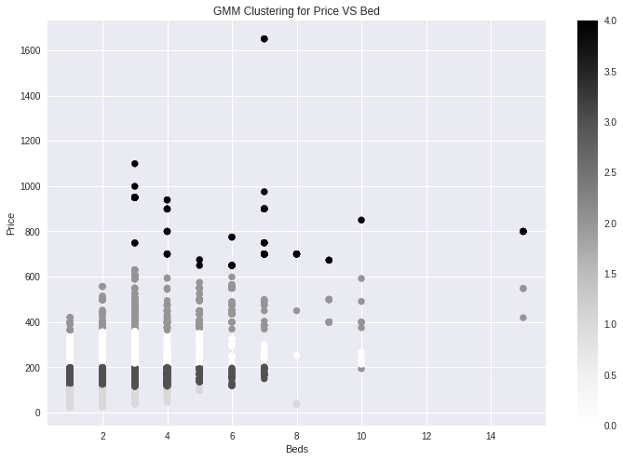
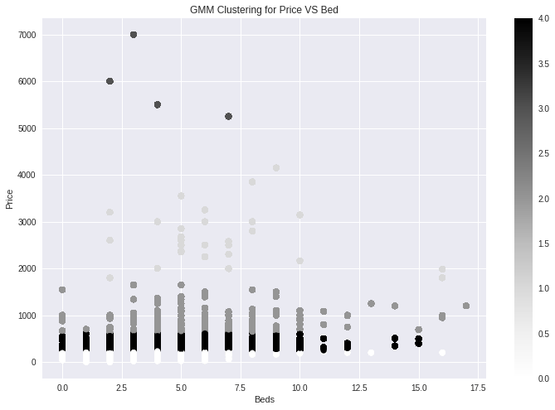
GMM
Seattle Sandiego

Slide 18
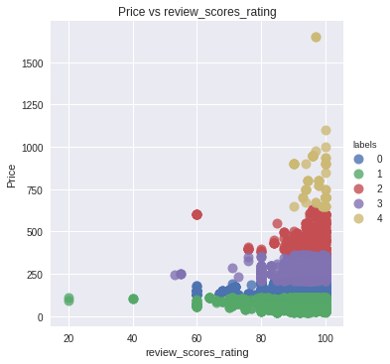
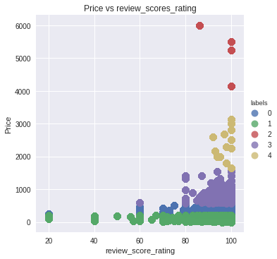
Kmeans
Price and Review scores
Seattle Sandiego
Notes:
Outlier
Seattle
Reviews 100 - price is 1600

Slide 19
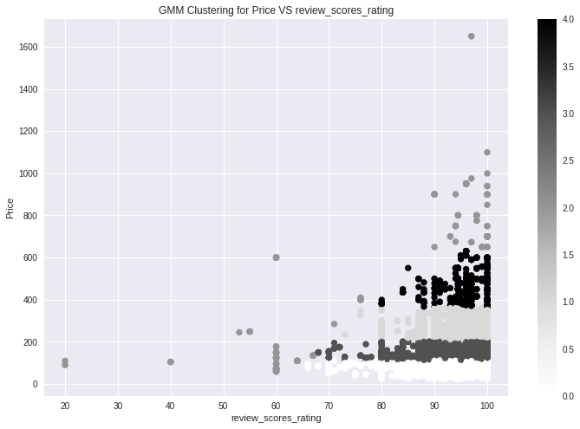
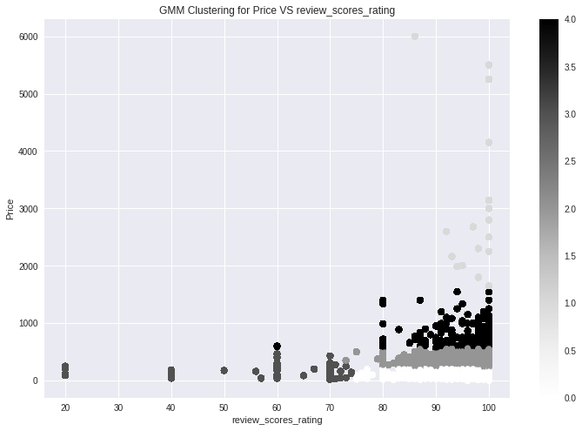
GMM
Seattle Sandiego
Notes:
we saw all other features like price vs bed ,price vs review,price vs bedroom, price vs accommodates it correlates positively so we wanted to include multiple features

Slide 20
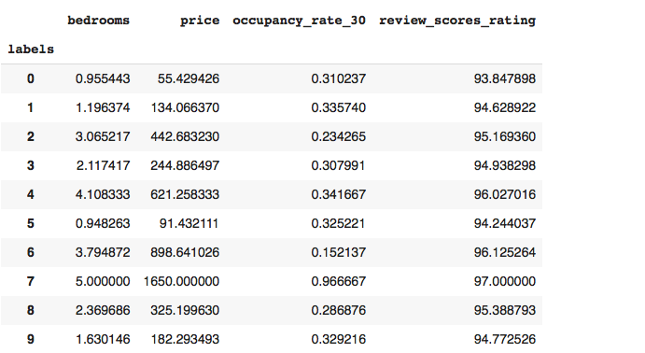
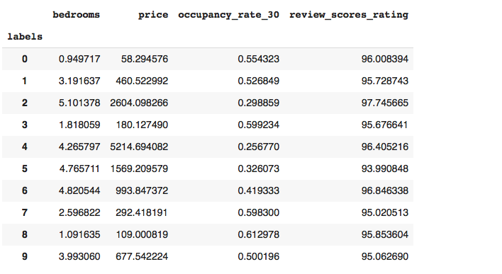
Kmeans
(Bedrooms,price,occupancy rate,review ratings
Seattle Sandiego
Notes:
Here is the comparetive score for kmeans for san dieogo and Seattle for multiple fetaures

Slide 21
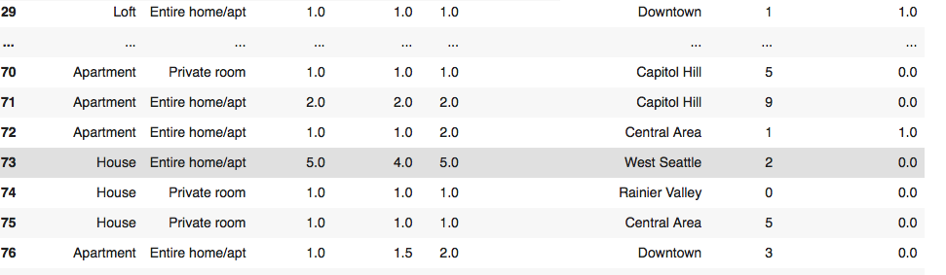
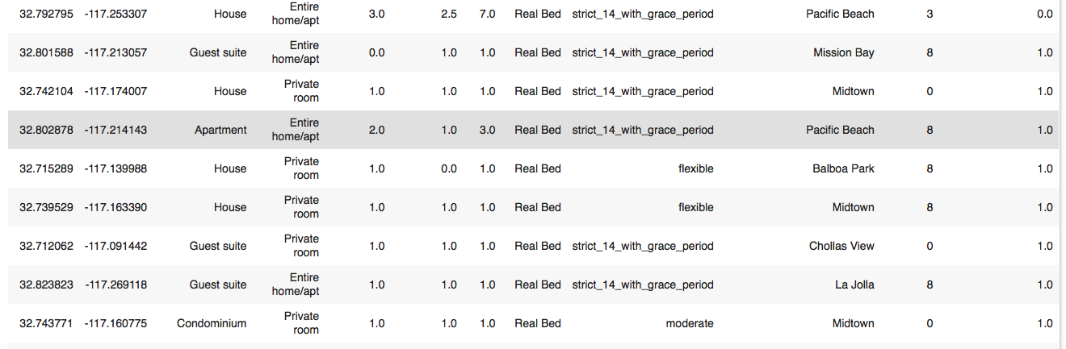
Competitive Neighbourhoods
Seattle Sandiego
Notes:
from the competive neighbourhood we conclude Competitve places for
Seattle -Downtown,Capital hill,cental Area,Queen Ane
Sandiego - Mission Bay,Pacific Beach,Midtown,La jolla

Slide 22
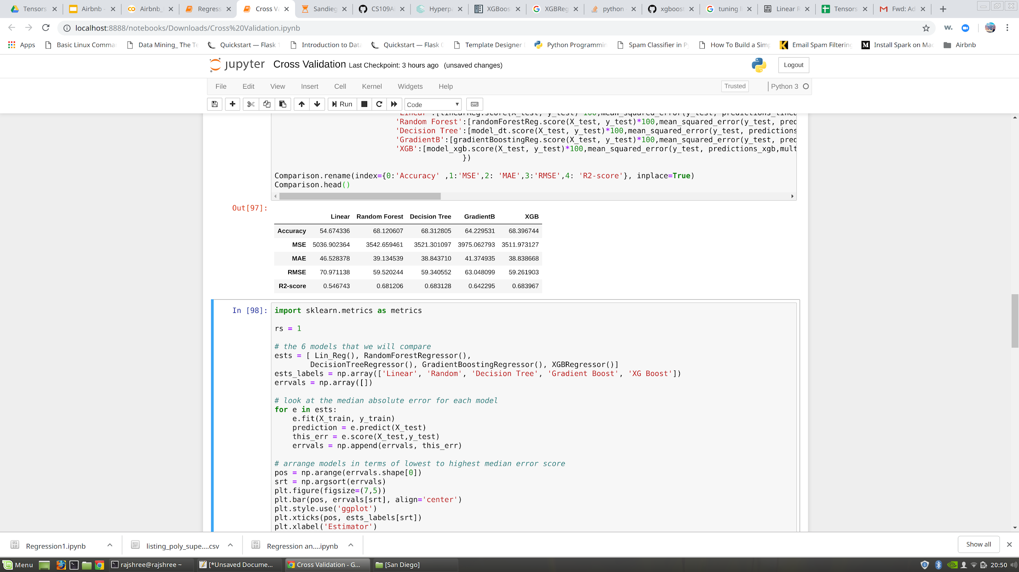
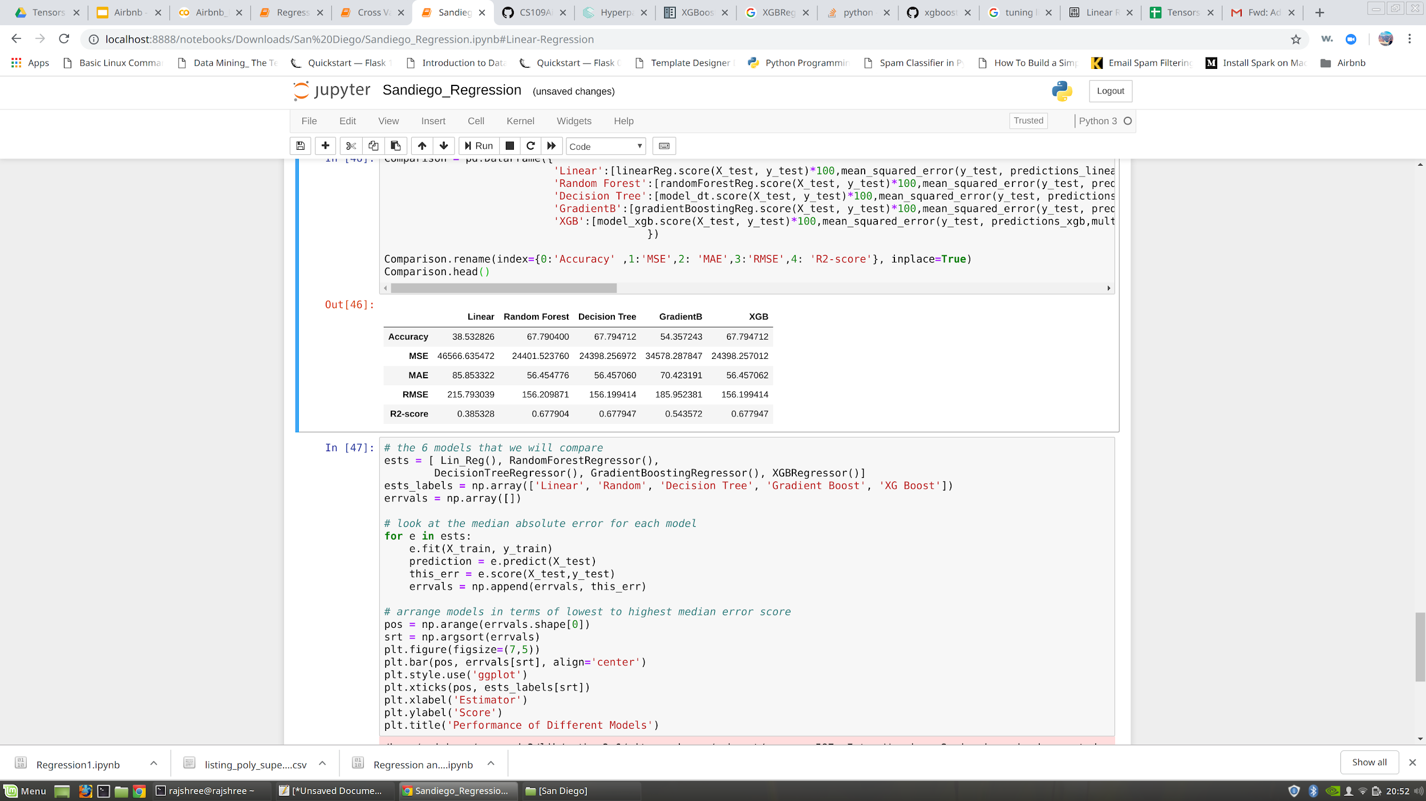
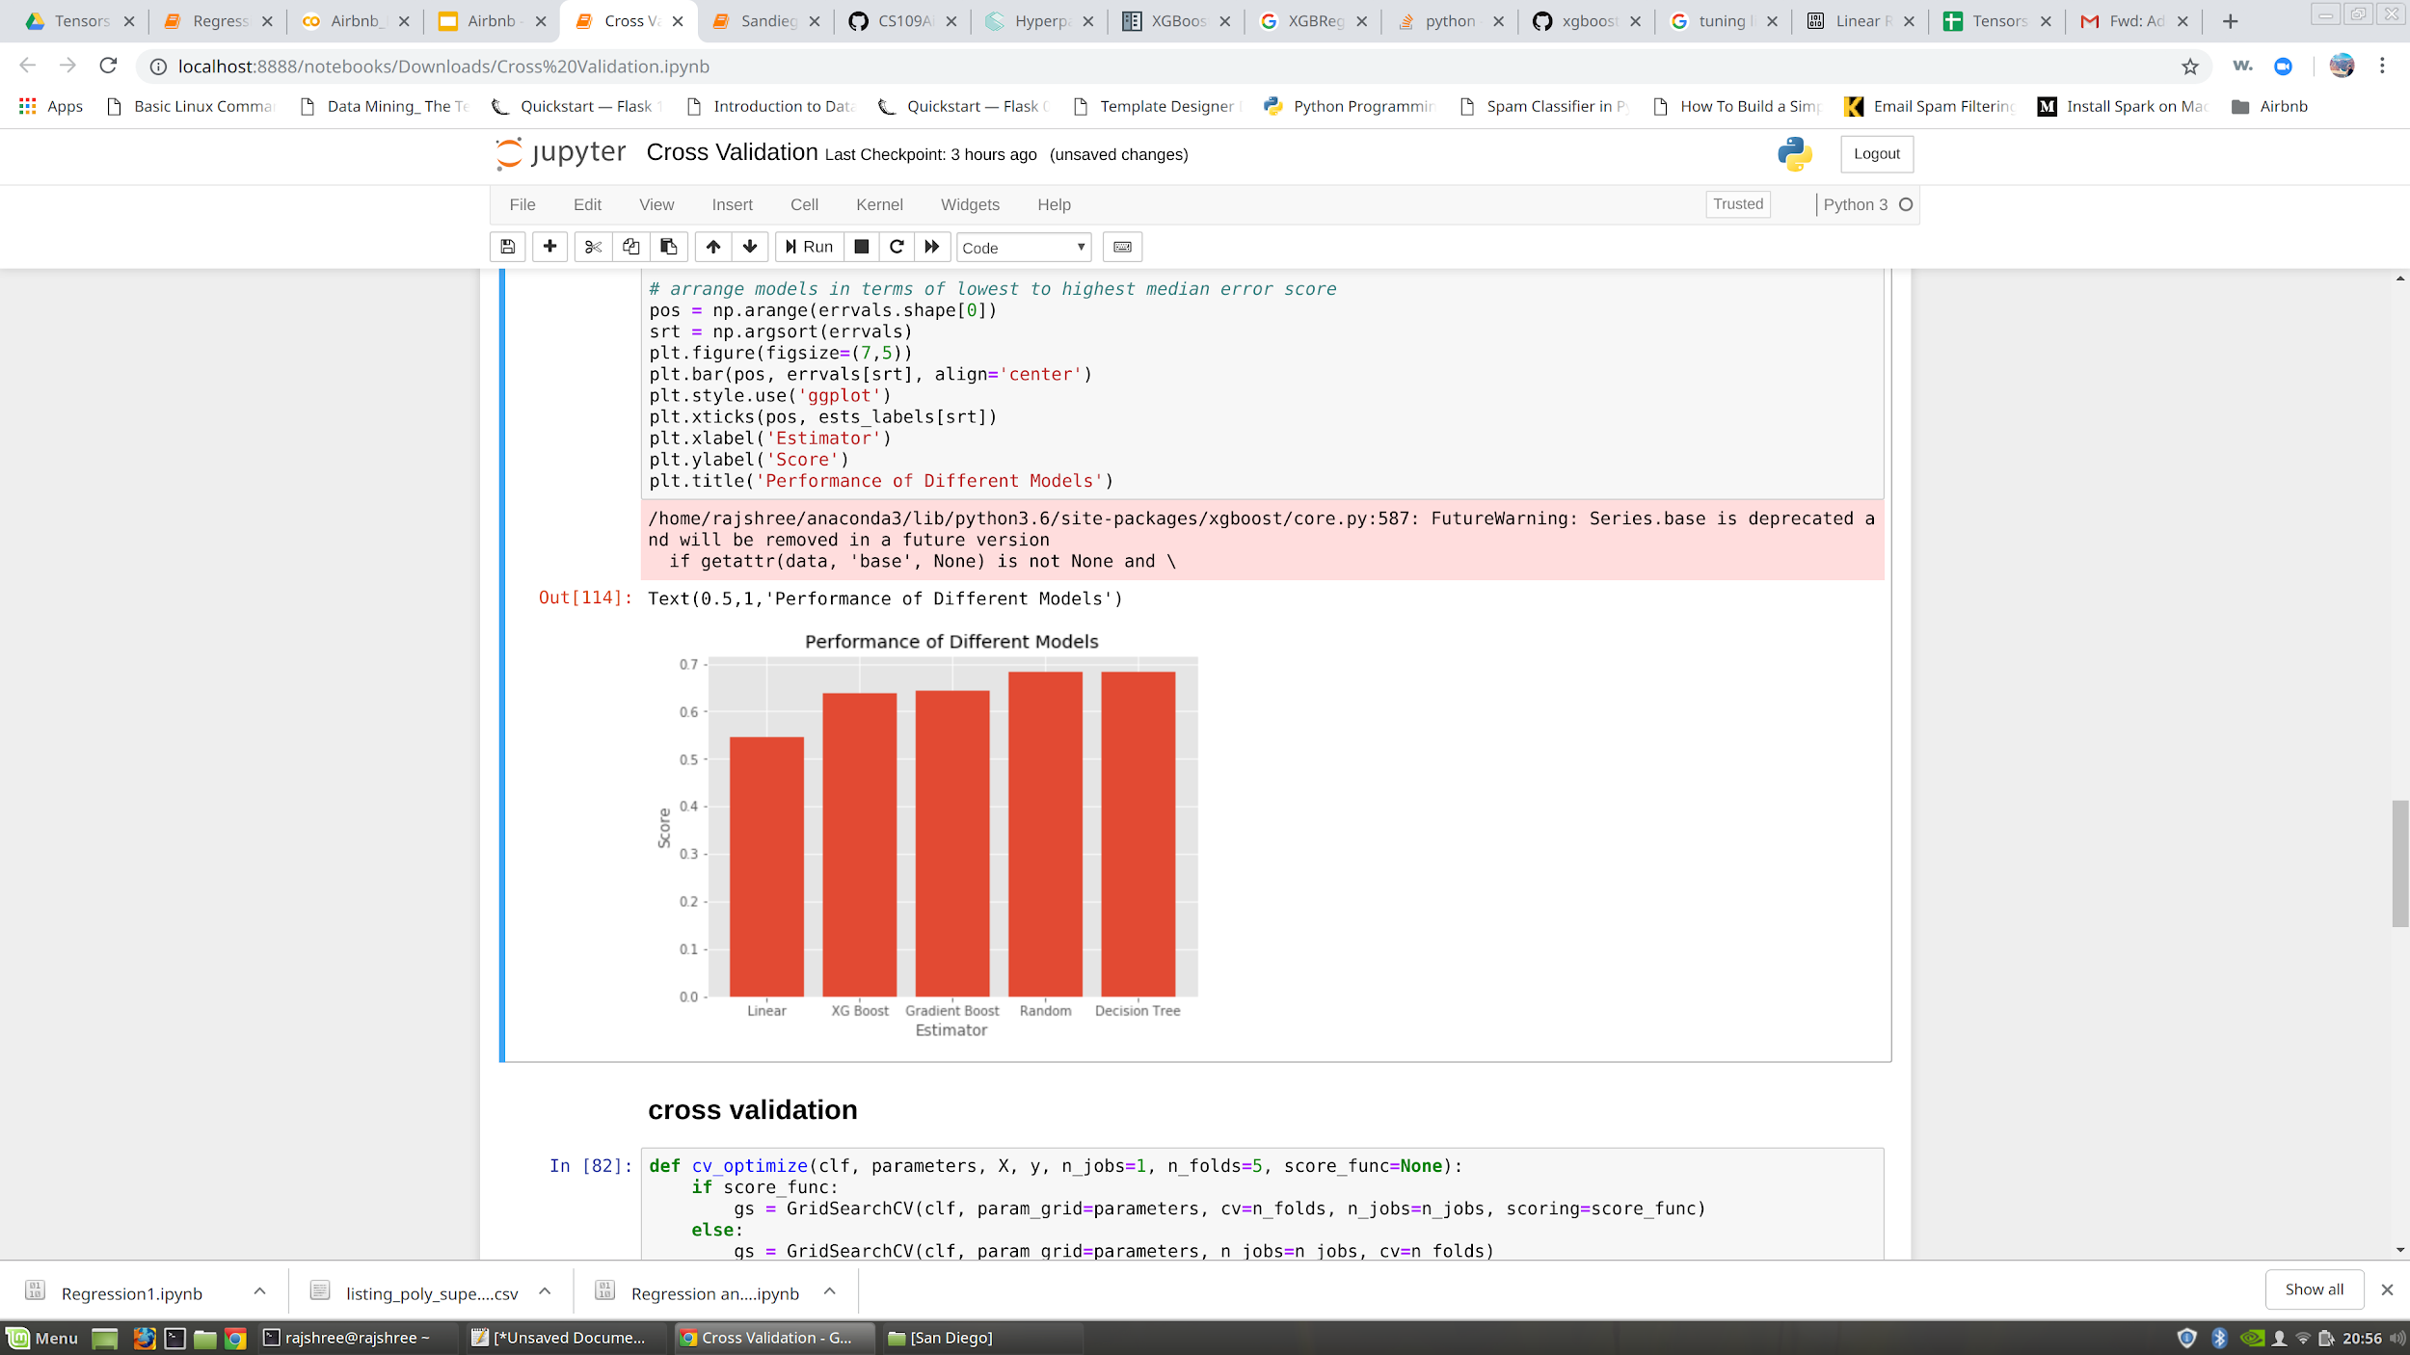
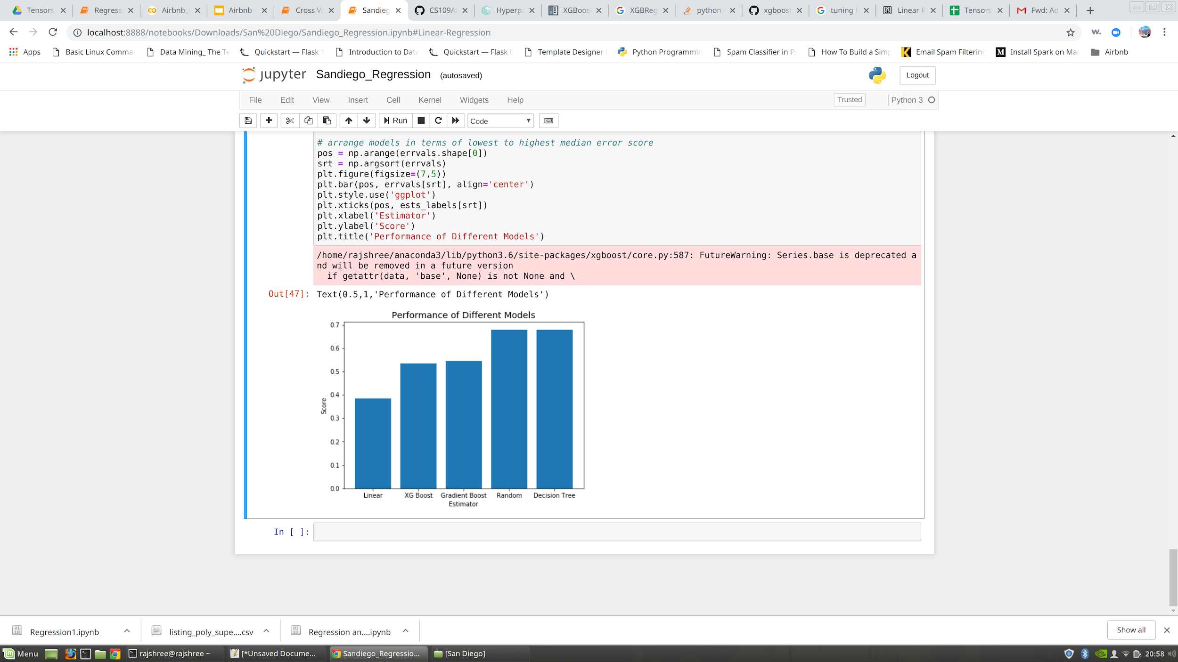
Regression
Seattle San Diego
Notes:
By doing regression to understand the forms of relationship with these features the best results for random forest

Slide 23
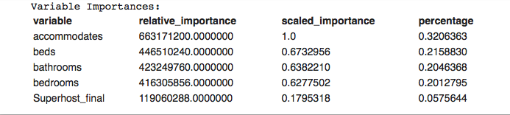
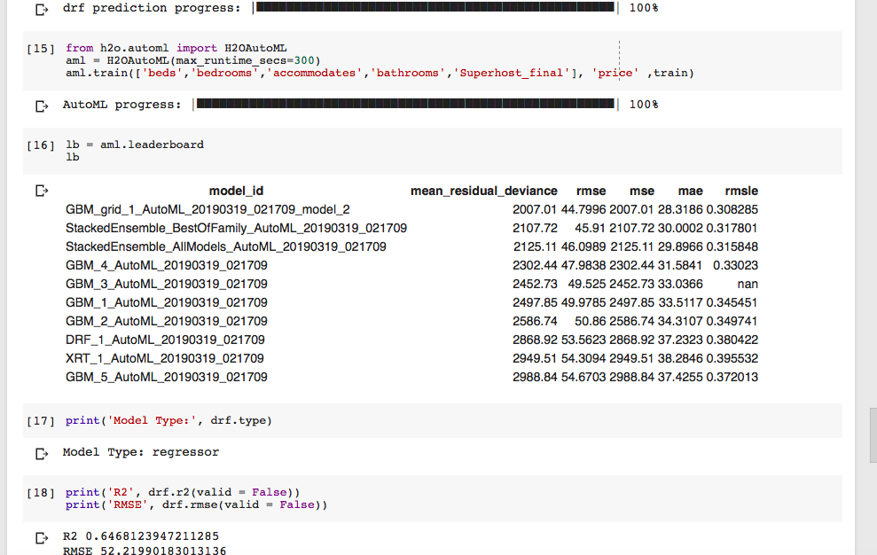
H2O Auto ML Scores
Feature Importance
Notes:
After all the manual methodologies we tried by using H20 Auto ML to check for the scores .. In regression feature importance accommodates beds bathrooms bedroom superhost---similarity leaderboard gives best models and respective scores and our score is 0.6

Slide 24
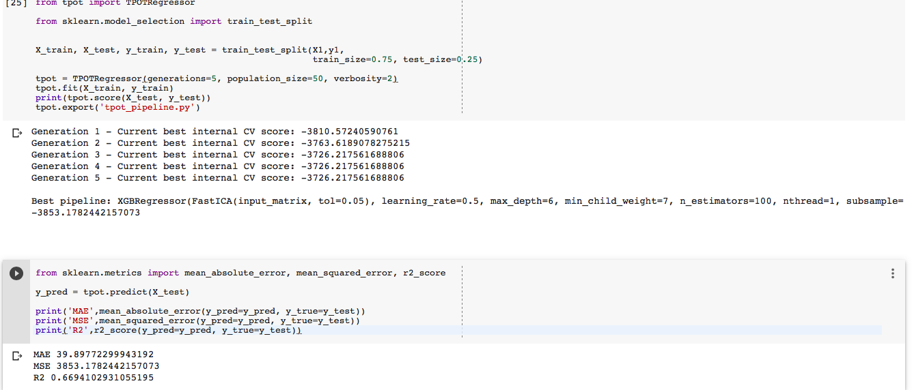
TPOT Auto ML Scores
W/o Superhost Polynominal
Notes:
We have tried TPOT it will run through 1000 of models and gives us pipeline which suits our dataset.for our features likes accommodates ,bed,bathroom,bedroom we got score of 0.66 and XGBregressor as best pipeline these are without superhost polynomial.

Slide 25
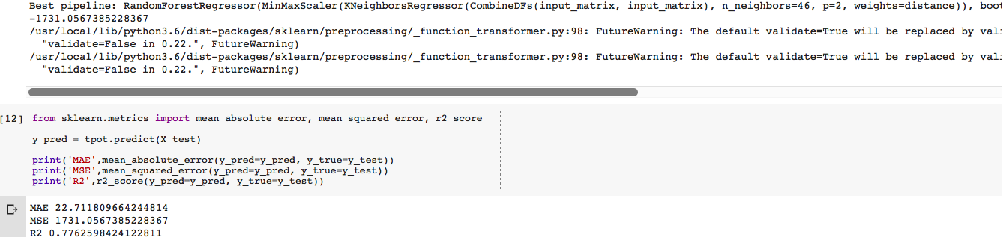
With Superhost Polynominal
Notes:
when we added superhost poly our score change from 0.66 to 0.77.

Slide 26
Conclusions
1.Which areas to invest in Seattle - Downtown,Central Area,Queen Ane
2. Price correlation with other features - Accommodation,Bedrooms,Bathrooms,Beds
3.Distillation - Location
4.Latent Variable -Superhost ,Location
Notes:
Our findings show that location is the most important feature when determining a price for an Airbnb listing in seattle and san diego. When we started this project, we hoped to increase the transparency of the pricing process by understanding which features were most correlated price. Using random forest , we were able to predict Airbnb prices with a high accuracy. Moving forward, when we tested the san diego data on seattle model we didn't get score as expected so we would like to look more into this we would future want to perform cross validation on our model to see if we can future improve.

Slide 27
References
https://scipy-lectures.org/packages/scikit-learn/auto_examples/plot_bias_variance.html
https://scikit-learn.org/stable/auto_examples/model_selection/plot_learning_curve.html
https://scikit-learn.org/stable/auto_examples/model_selection/plot_precision_recall.html
https://scikit-learn.org/stable/modules/generated/sklearn.ensemble.RandomForestRegressor.html

